Slide 1

Colechain
Innovating & Analyzing blockchain

Slide 2
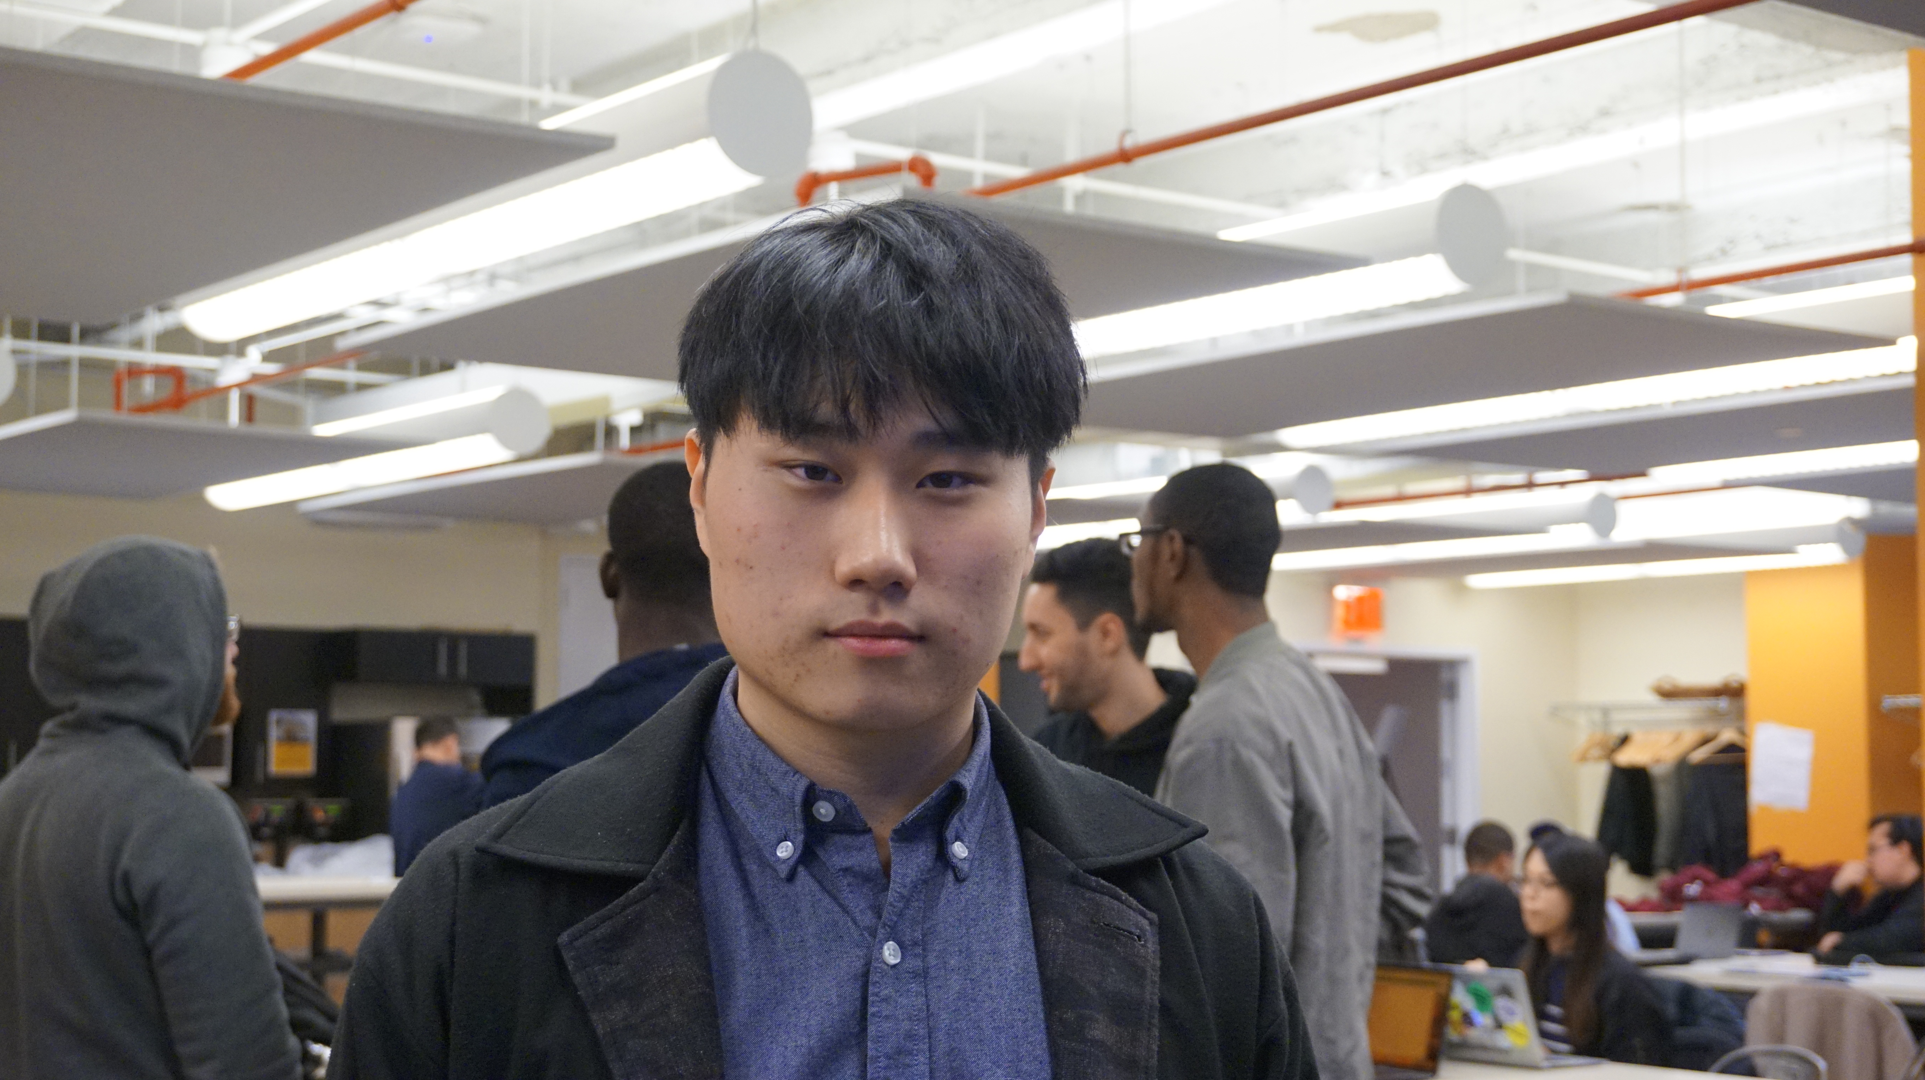
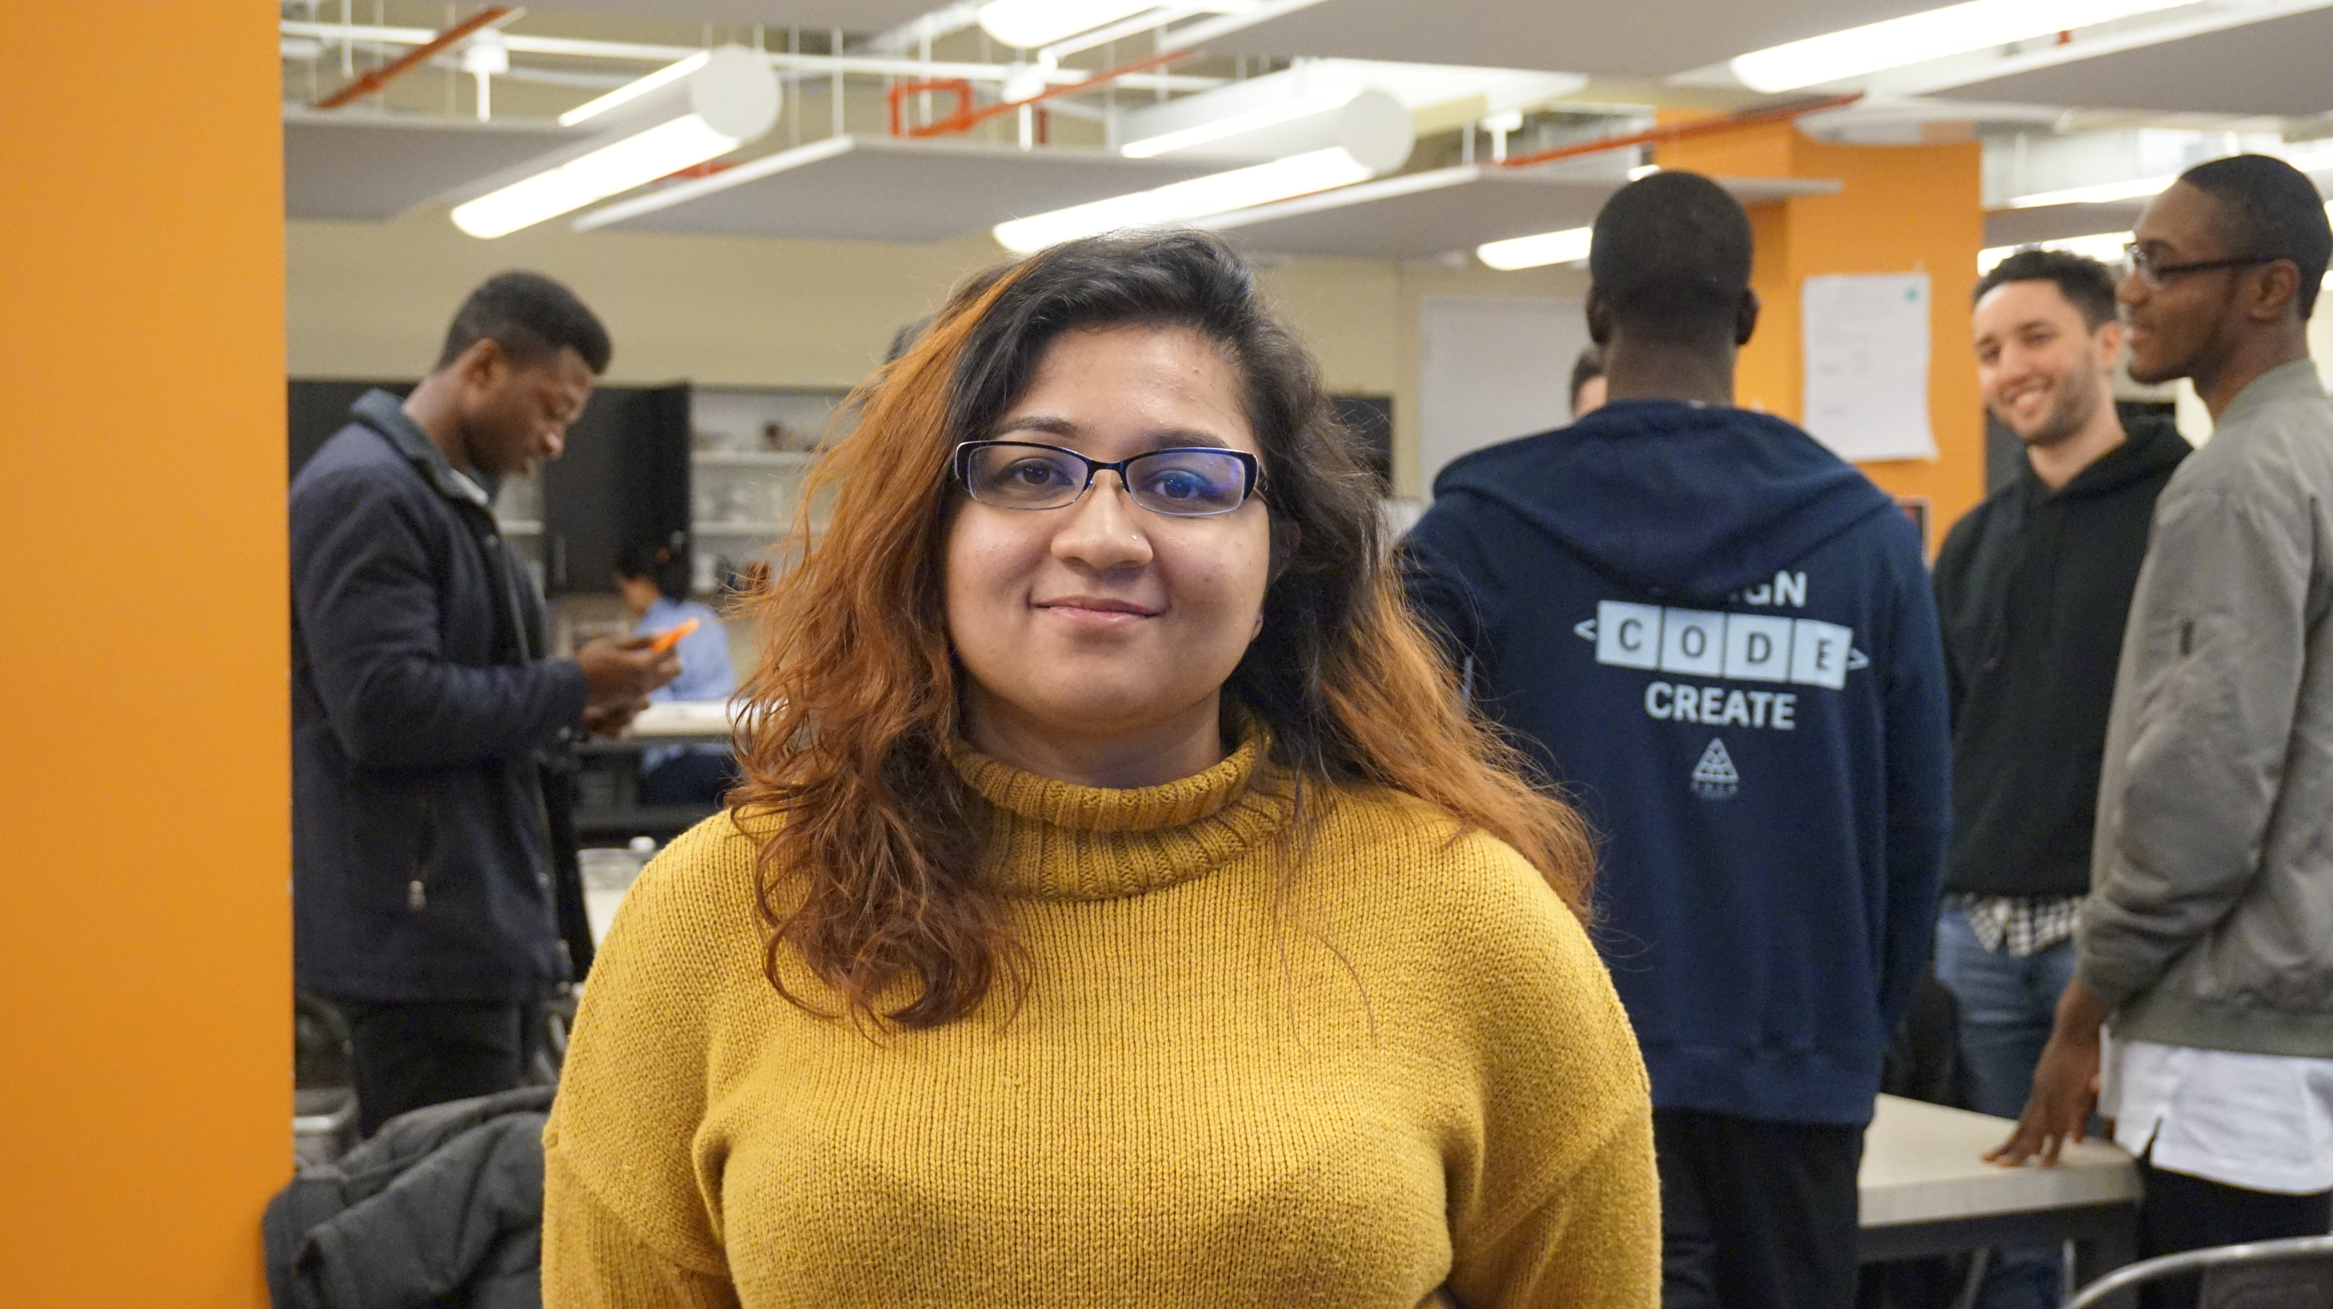
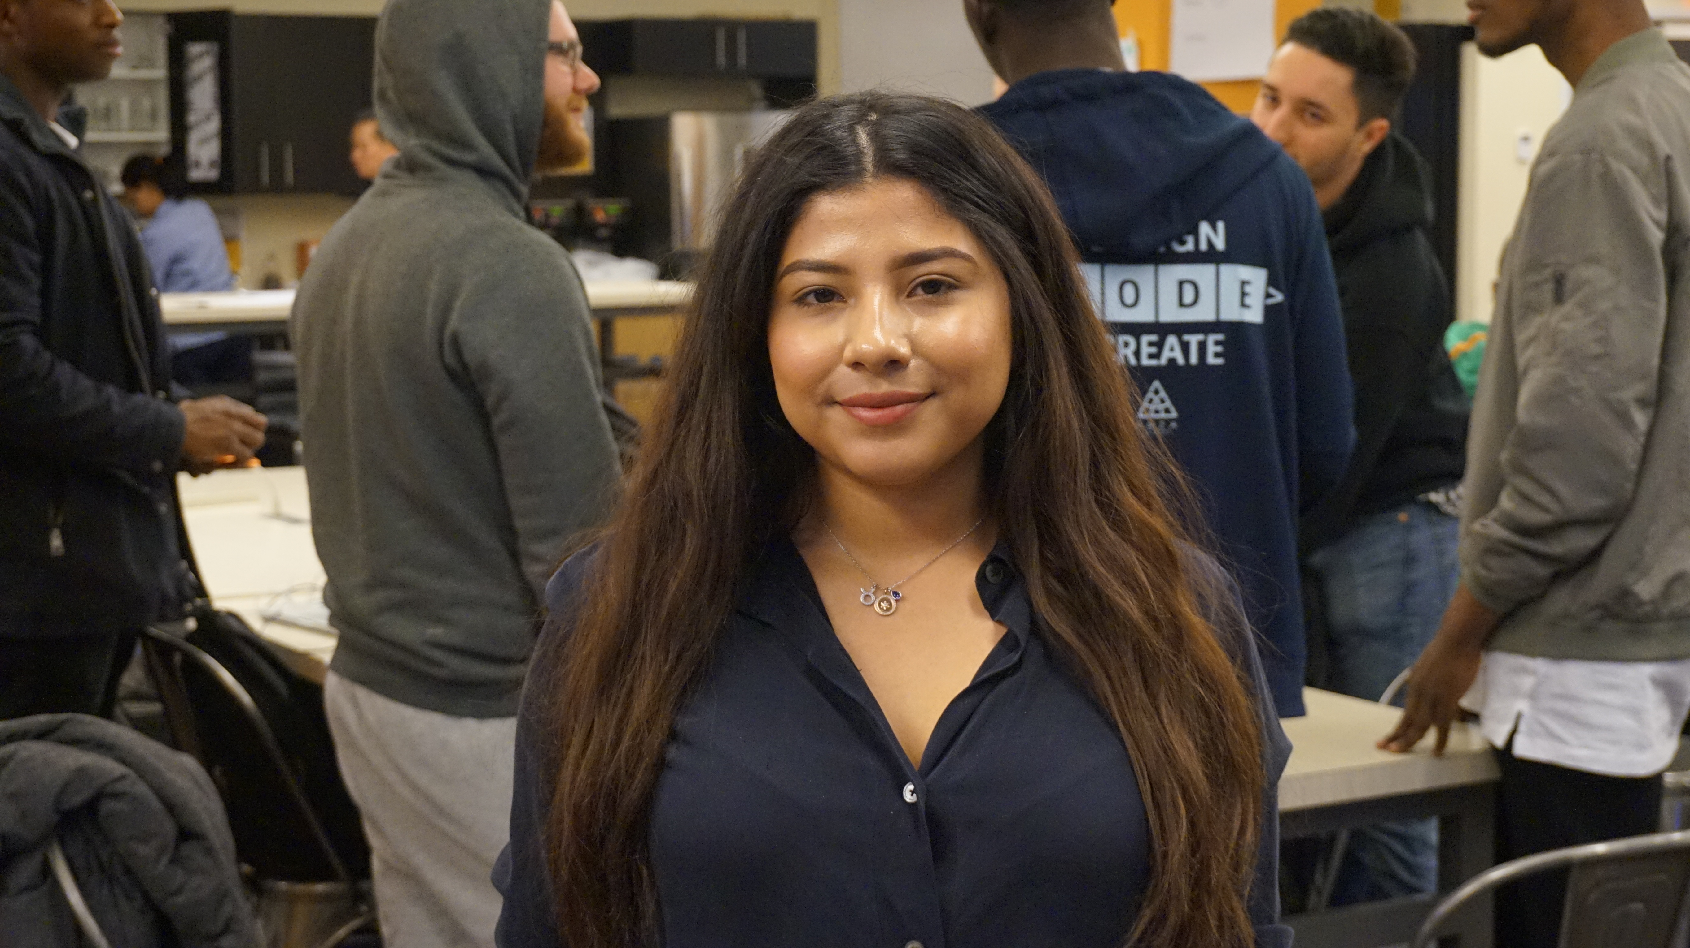
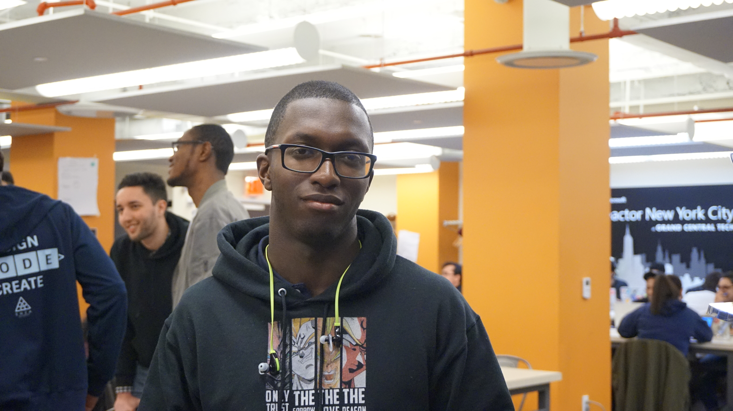

Team- Challenge #1
Taehun Lim Project developer
Sumaita hussain Backend developer
Leslie jargueta
Frontend developer
Daniel Gaston
Backend developer
President & founder of crypto club @CCNY
Facilitator of cybersecurity course
Leading backend developer of Invention Corps

Slide 3
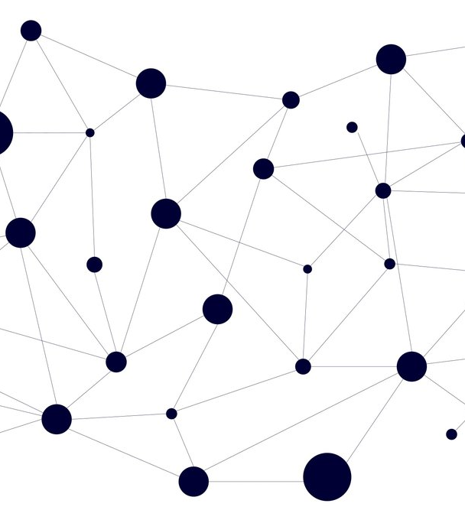
Problem
People doesn’t know how much they should be getting paid which creates inequality of salary based on intristic value(e.g Gender)

Slide 4
Today’s Solutions
Using a 3rd party website (i.e. Glassdoor)
2. Asking co-worker of how much they’re getting paid

Slide 5
Why it doesn’t work
Inaccurate
Not transparent
Inefficient
Truth/Trust

Slide 6
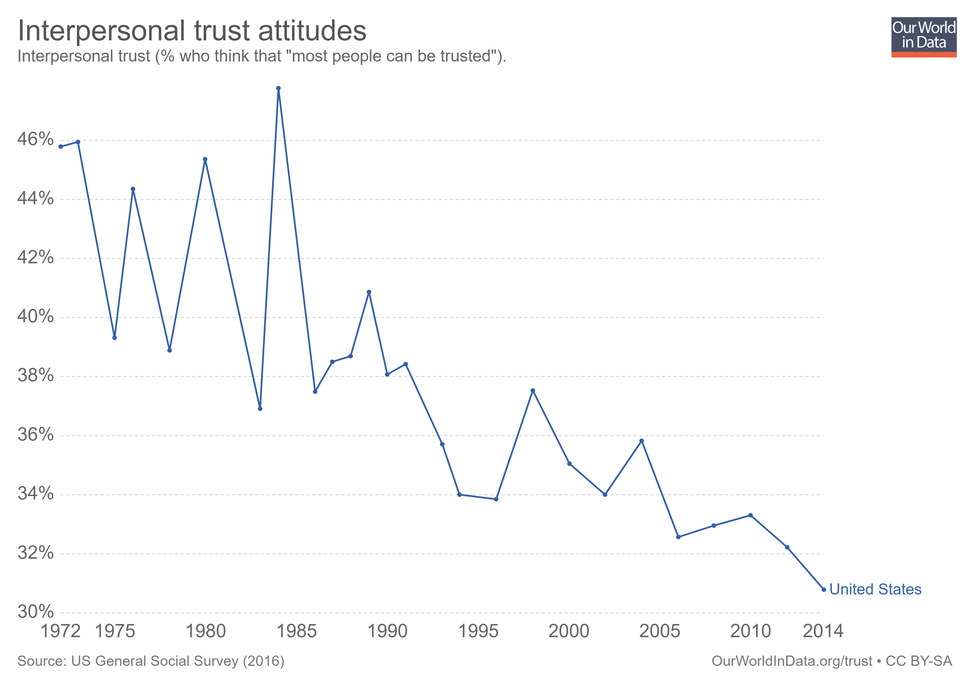

Slide 7
Our solution
Create a blockchain platform that has data of payroll only based on
extrinsic factor

Slide 8
Product
Blockchain platform with decentrailized ledgers
Algorithm for data analysis of those ledger

Slide 9

Why not centralized ledger with one party owning all the data?

Slide 10
Awesome features of using blockchain
Security
No point of failure
Data is cryptographically signed
Accuracy
Efficiency

Slide 11
Truth/Trust

Slide 12
How data Analysis Works
Create Ledger
Customer’s Info
Extract data
Determine average salaries
Generate expected pay
Salary, Skillset, Average Proficiency, Company
Notes:
Aggregate data from companies through surveys – company, salary, hard skills (i.e. c#, react.js, nosql), and weighted proficiency
Extract data from ledger
Use data to find average salary of job titles, taking skillset + proficiency into account
Now clients can, using their qualifications, look up how much they can expect their salary to be in a certain company

Slide 13
Project Demo
Blockchain Ledger
Client
Microsoft
Andy - 100k
C++, Java, MySQL
Proficiency: 85%
Apple
Alice - 90k
C++, Java
Proficiency: 90%
Facebook
David -80k
C++
Sally
Skills: C++, C#,
Node.js
Looking for:
Entry Level Software
Engineer
Output –
Sally’s expected
Salary is 80k

Slide 14

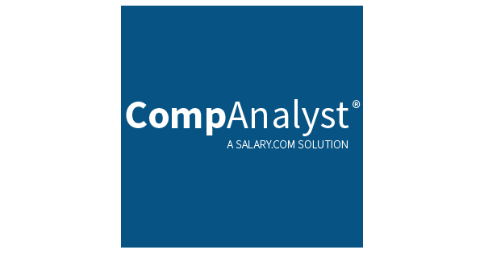

Competitors

Slide 15
High Security
MSI
ColeChain
Glassdoor
Companalyst
High Accuracy
Low Accuracy
Linkedin Salary
High Efficienty

Slide 16
 | YOUR COMPANY | GlassDoor | MSI | Salary.com
Best security
Accurate Data
Low-cost
Ease of accesing data

Slide 17
Business Model
Data analyzation
Company
Blockchain
Company wants to stop spending money on salary Evaluation
Company uploads their payroll data on blockchain we created
Using algorithm, we analyze ledger in which will provide company how much they should be paying certain employee

Slide 18
Business Model- Revenue source
Initial
Free Service
Middle
Trial period
Final
Charge yearly subscription based on number of employee
Blockchain Analytics
80% of revenue
Advertisement
20% of revenue
B2C
B2B

Slide 19
Market Size
$40.8b
$10b
$.55b
Big Data
Compensation Survey
Blockchain
Source : statisca
Source : salary.com
Source : statisca

Slide 20
Market Size Size over Time: Big data
Market Sizing (in $billions)

Slide 21
Marketing- B2B
Company can access the ledger if they update their data
Can save about 20k a year using our data analytic product
Contributing to open source
Blockchain Hype
Implement of new technology
Equality
Good PR

Slide 22
Thanks for listening

Slide 23
Forecast

Slide 24
Financial Table
 | 2016 | 2017 | 2018 | 2019 | 2020
Sales | 0 | 50 | 400 | 1000 | 3000
Revenue | - | $100 000 | $800 000 | $2 000 000 | $6 000 000
Gross Margin (%) | - | 49% | 51% | 53% | 58%
Expenses | - | $128 000 | $450 000 | $800 000 | $1 200 000
Net Profit | - | $-28,000 | $350 000 | $1 200 000 | $4 800 000
Profit Margin (%) | - | -28% | 44% | 60% | 80%

Slide 25
Outstanding Founders
Dave Lopper CTO
Come Mertial CEO
Tran Zition
CPO
Google
Facebook
Stanford
Microsoft
SalesForce
HEC Paris
Uber
Awwwards
MIT Media Lab

Slide 26
Roadmap
02/2016
04/2016
06/2016
Market Overview
Pre-Release
Launch
01/2016
03/2016
05/2016
Introduction
Partnerships
Beta

Slide 27
Say you want to make the world a better place

Slide 28
Icons

Slide 29
Icons

Slide 30
Social

Slide 31
Red
Pink
Purple
Deep Purple
Indigo
Blue
Light Blue
Cyan
Teal
Green
Light Green
Lime
Yellow
Amber
Orange
Deep Orange
50
50
50
50
50
50
50
50
50
50
50
50
50
50
50
50
100
100
100
100
100
100
100
100
100
100
100
100
100
100
100
100
200
200
200
200
200
200
200
200
200
200
200
200
200
200
200
200
300
300
300
300
300
300
300
300
300
300
300
300
300
300
300
300
400
400
400
400
400
400
400
400
400
400
400
400
400
400
400
400
500
500
500
500
500
500
500
500
500
500
500
500
500
500
500
500
600
600
600
600
600
600
600
600
600
600
600
600
600
600
600
600
700
700
700
700
700
700
700
700
700
700
700
700
700
700
700
700
800
800
800
800
800
800
800
800
800
800
800
800
800
800
800
800
900
900
900
900
900
900
900
900
900
900
900
900
900
900
900
900
A100
A100
A100
A100
A100
A100
A100
A100
A100
A100
A100
A100
A100
A100
A100
A100
A200
A200
A200
A200
A200
A200
A200
A200
A200
A200
A200
A200
A200
A200
A200
A200
A400
A400
A400
A400
A400
A400
A400
A400
A400
A400
A400
A400
A400
A400
A400
A400
A700
A700
A700
A700
A700
A700
A700
A700
A700
A700
A700
A700
A700
A700
A700
A700

Slide 32
Gradient 1

Slide 33
Gradient 2

Slide 34
Gradient 3

Slide 35
Gradient 4

Slide 36
Gradient 5

